Slide 1
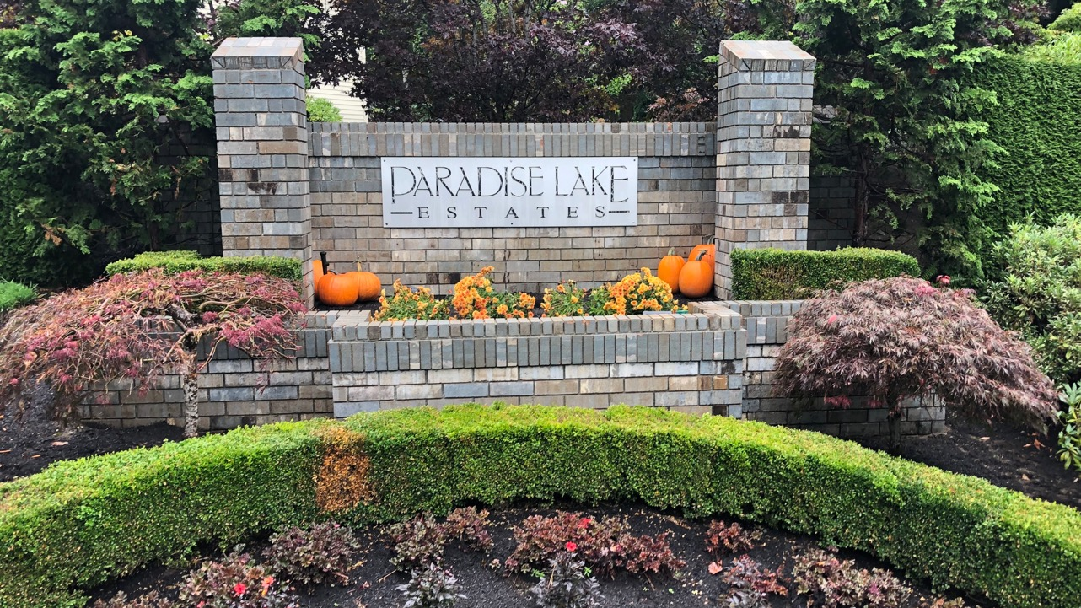
PLE HOA Fall Meeting
November 15, 2019

Slide 2
Agenda
Introductions
(5 minutes)
PLE HOA Board Vision
(20 minutes)
Finance Update
(20 minutes)
2020 Board Member Elections
(20 minutes)
Refreshments

Slide 3
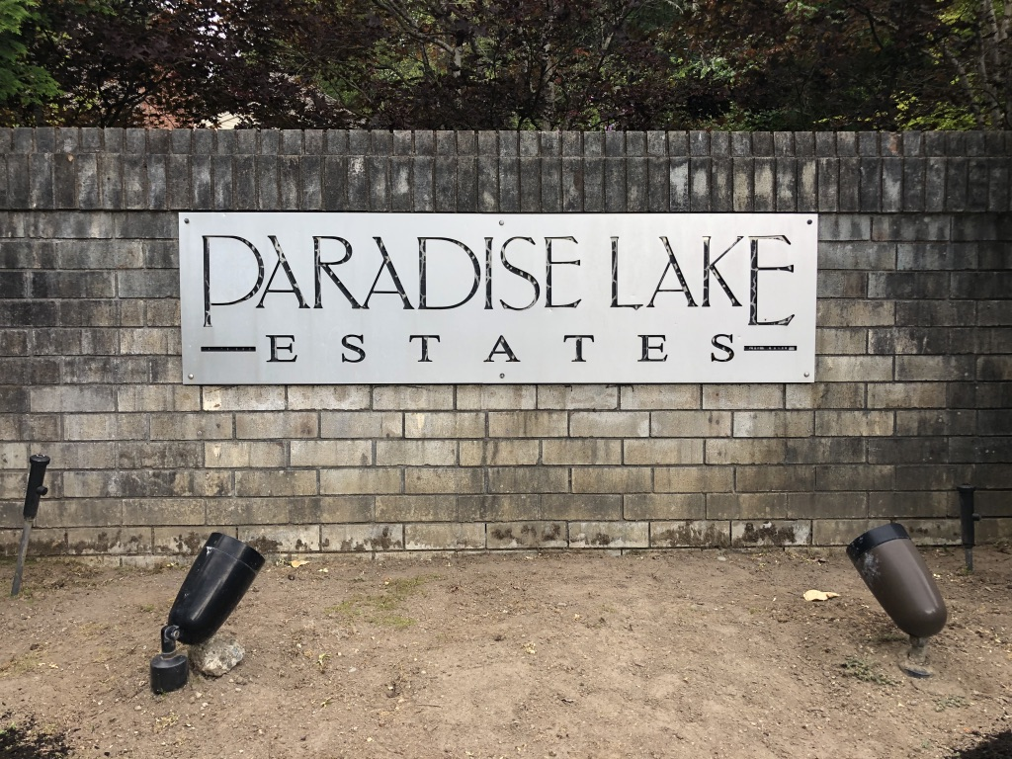
Addressing Challenges
Challenges over past 5-10 years
  Poor communications
  Limited financial reporting
  Little community involvement
  Overgrown trees & landscaping
  Eroded gravel, pot holes
  Monument in poor condition
  Community spirit?

Slide 4
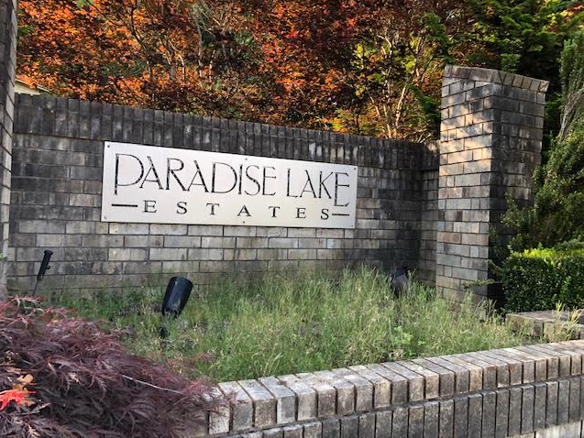
Addressing Challenges
Challenges over past 5-10 years
  Poor communications
  Limited financial reporting
  Little community involvement
  Overgrown trees & landscaping
  Eroded gravel, pot holes
  Monument in poor condition
  Community spirit?

Slide 5
Introductions – interim board members

Slide 6
Addressing Challenges Together
Informed
Involved
Improving

Slide 7
Informed
Regular, better communications
New web site – THANKS MICHELLE!
  PLEHOA.ORG
Online Q&A, input
E-mail alerts
HOA Meeting minutes
Upcoming projects
Accessibility

Slide 8
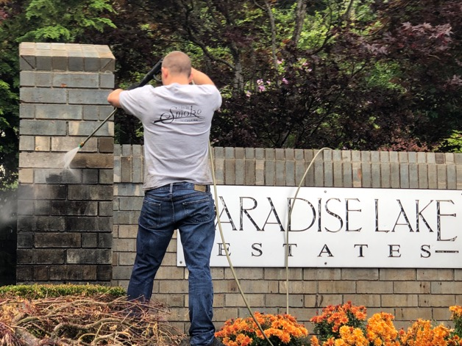
Involved
Community participation in projects = lower dues through “sweat equity”
More community volunteers for future improvements
Street Reps nominated - more needed
Community spirit
  Decorations
  Labor Day Party
Neighborhood reviews

Slide 9
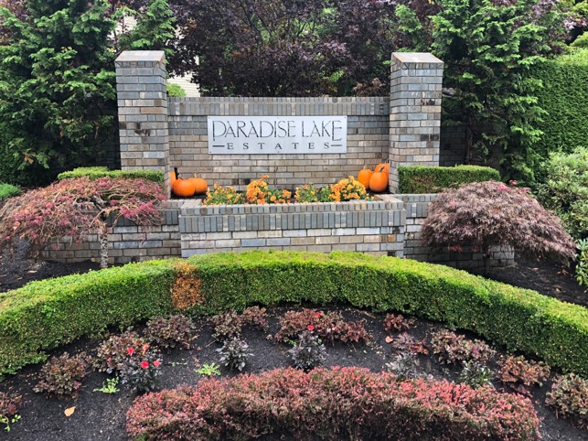
Improving
Since August…
Monument
  Power wash, solar lights, battery powered sprinkler control, weeding, flowers, seasonal decorations
Shoulders repaired by King County
Mailbox kiosks painted, nails removed
New landscaping contractor
4 compliance issues addressed
Overgrown trees trimmed
Fence cleaned
Gravel cleaned

Slide 10
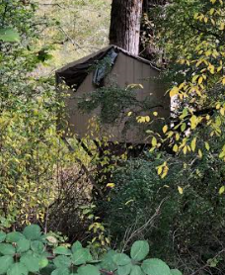
Next Improvements
Remove 2 treehouses (volunteers please?)
Continual gravel maintenance and replacement
Landscaping improvements and maintenance
Prepare for contingencies – snow plowing, windstorms, etc.
Group-based community compliance reviews
CC&R updates: 27 years old and never amended
  Roof & antenna changes are under review
  Other changes TBD, with proper approval

Slide 11
Vision Q&A

Slide 12
PLE HOA Treasurer’s Report, November 15, 2019: Executive Summary
2019
  Year End Projected Balance = ~$17.4K, as budgeted
    ~$5K of volunteer labor allowed additional cleanup to be done within budget
2020
  Projected Expenses = $13.8K
  Dues at current level of $375/year = $12.0K, $1.8K shortfall
  Therefore, to have a balanced budget, dues would increase by 15% to $430/year
    32 x $430/year = $13.8K.
Reserve Account for Asset Replacement, Contingency and First 3 Months
  Target Reserve at YE 2020 = ~$17K

Slide 13
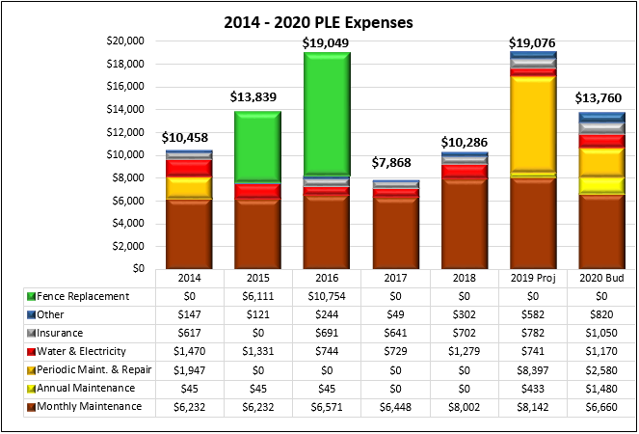
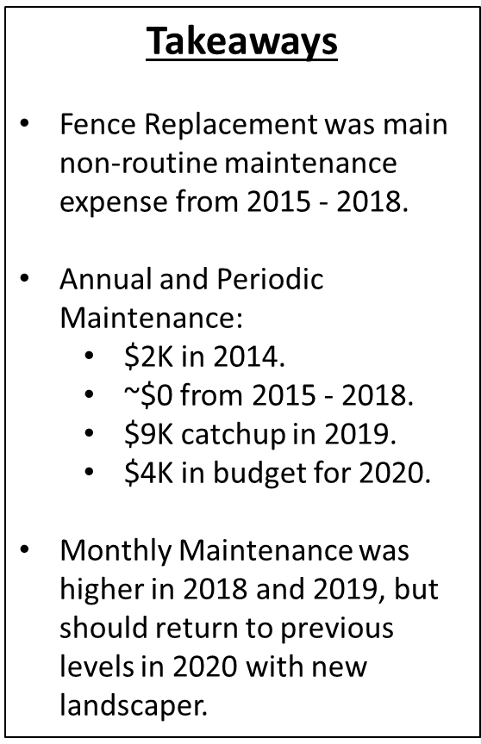
PLE Expenses

Slide 14
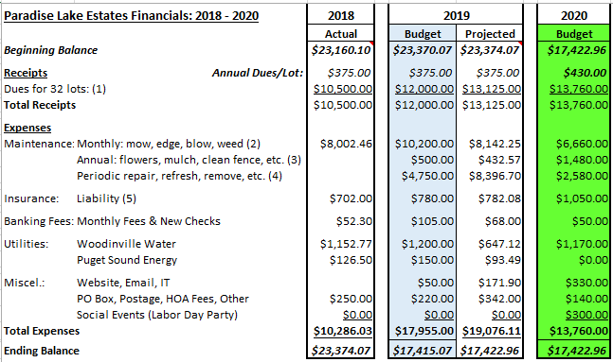
2020 Budget Comparison
$600 for flowers & mulch
$750 for fence cleaning
$130 for irrigation maintenance
$1,480 total annual maintenance
Various projects, depending on volunteer support, including:
Treehouse removal
Common gravel additions
Tree and branch removal
Solar light upgrade
Other

Slide 15
Reserve Requirements for YE 2020 = ~$17K
Repair and Replacement of Assets; Target Balance at YE 2020 = ~$9K
  Fence: 5 years of 30 year life with ~$21K replacement cost = $3.5K
  Mailbox Kiosks: 20 years of 40 year life with ~$8.0K replacement cost = $4.0K
  Sign: 20 years of 30 year life with ~$2K replacement cost = $1.3K
  Note: contributions to the Repair and Replacement Reserve should = ~$1K/year.
Contingency = $5K
  Recommended for unforeseen expenses, vandalism, legal action, etc.
Amount Needed for January - March of the Following Year = $3K
  $1K/month expenses before dues are received in late-March

Slide 16
Finance Q&A

Slide 17
2020 Board Elections
Any other nominations?

Slide 18
Thank You

Slide 19
Financial Backup Slides

Slide 20
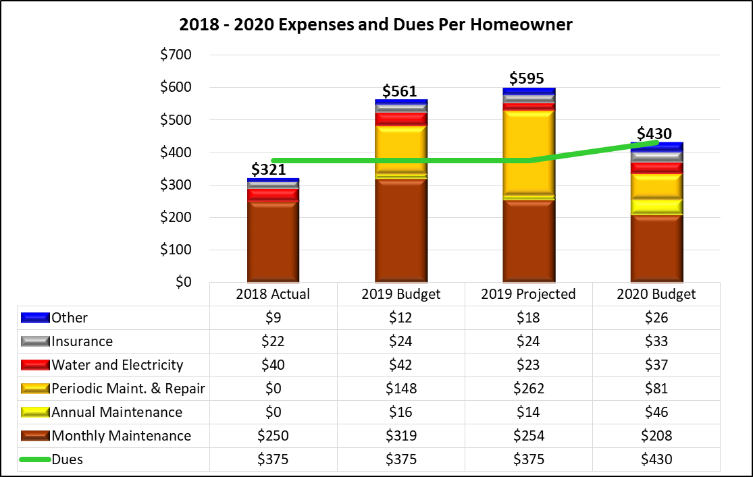
PLE Expenses and Dues Per Homeowner

Slide 21
2018, 2019 and 2020 Budget Comparison Notes

Slide 22
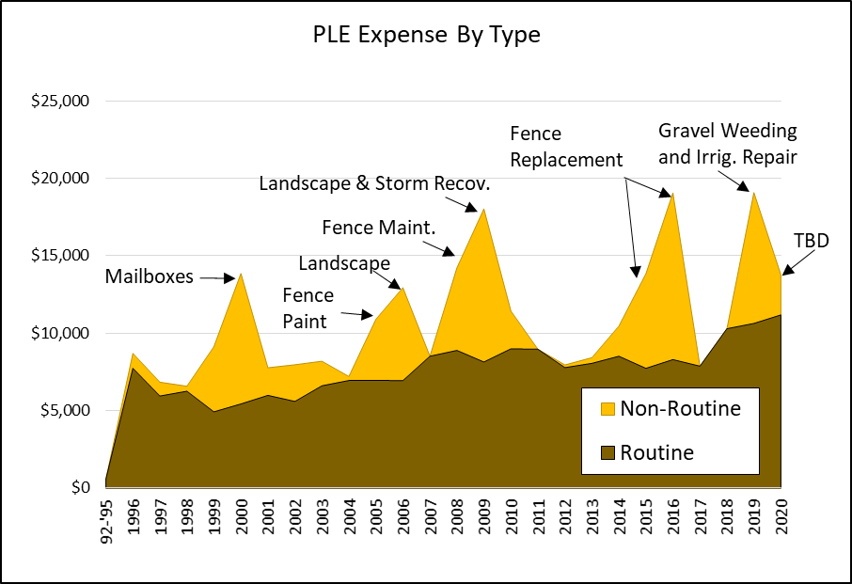
PLE Expense History
Significant Non-Routine Expenses
$5.1K for mailbox project in 2000
$3.2K for fence painting in 2005
$5.1K for landscape enhancement in 2006
$4.6K for fence maintenance in 2008
$6.6K landscape renovation and $3.3K for tree removal (storm related) in 2009
$16.1K for fence replacement in 2015 & 2016
$1.8K for irrigation repair, and $5.0K for one-time removal of weeds from gravel in 2019.
$2.6K for unspecified periodic maintenance in 2020.

Slide 23
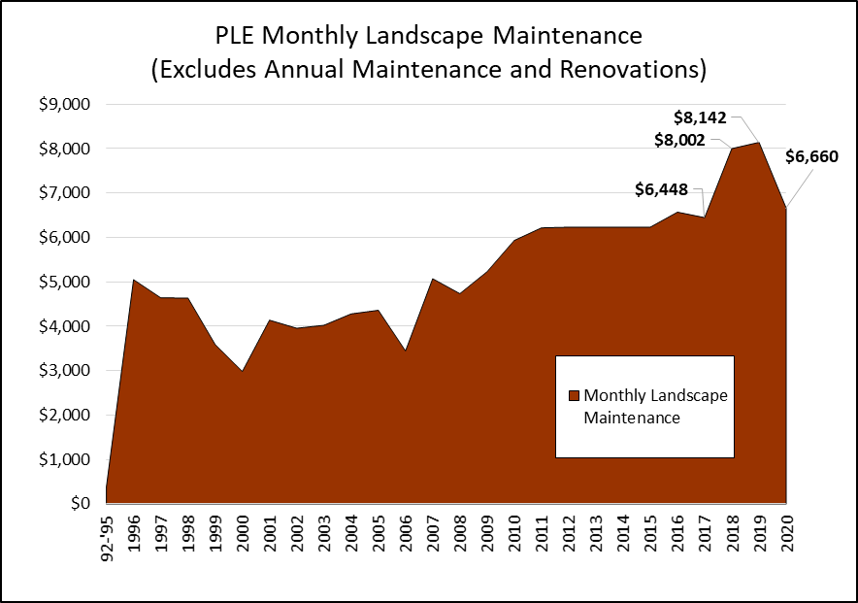
PLE Landscape Maintenance
Changes from $6.4K in 2017
2018 is $1.6K higher than 2017 because:
JP Landscape quit, replacements cost $1.6K more.
2019 is $1.7K higher than 2017 because:
2 replacement landscapers cost more and were unreliable. New provider, more reliable with slightly higher costs than JP Landscape, started in October.
2020 is only $0.2K higher than 2017 because:
New provider agreement continues through 2020.

Slide 24
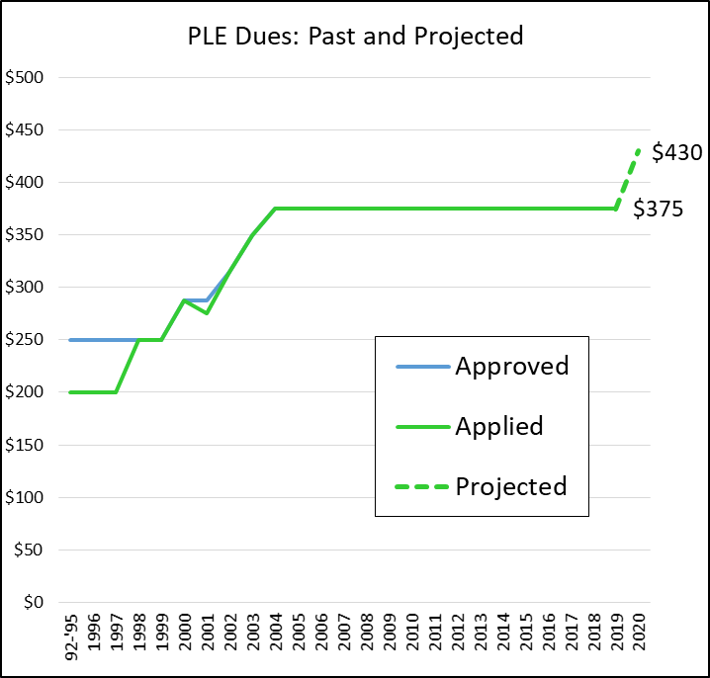
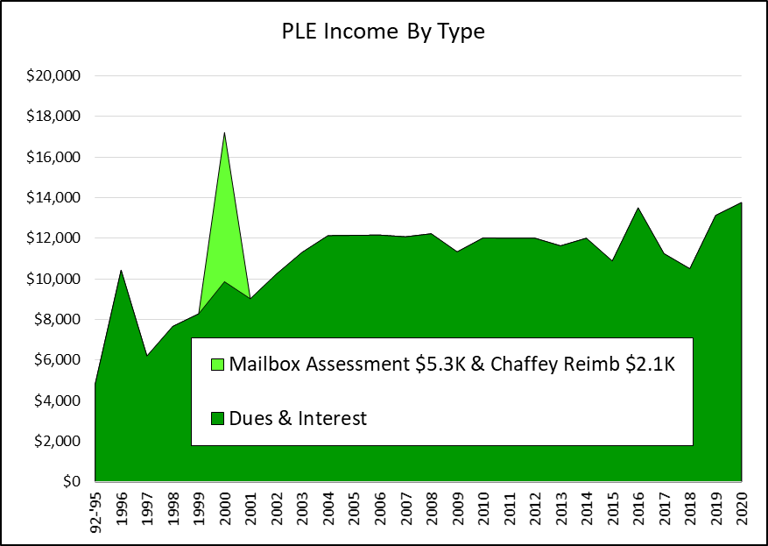
PLE Dues and Income History

Slide 25
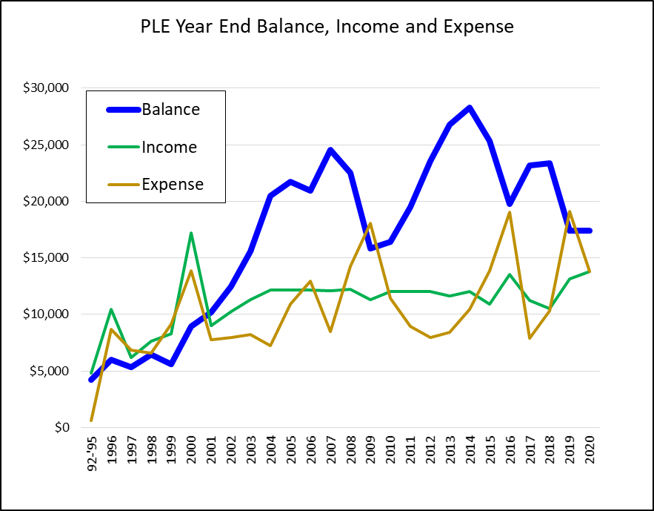
PLE Balance, Income and Expense

Slide 26
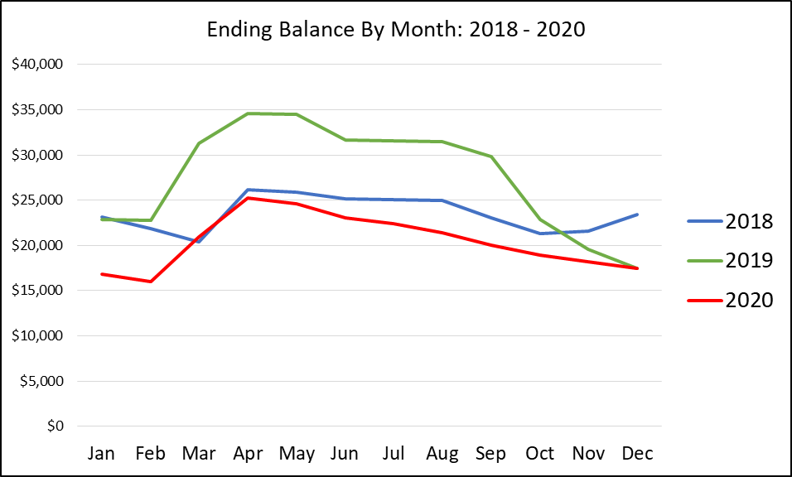
PLE Monthly Cash Balance

Slide 27
Summary of 2019 PLE Volunteer Labor: ~$5,000
Fence cleaned (first time since installation in 2015) = $1,500
Branches removed along 190th = $1,500
Mailbox Kiosks painted after staples and nails removed = $700
Monument pressure washed = $500
Bushes and Shrubs trimmed around the monument = $500
Weeds, Leaves and Debris removed during August and September when PLE did not receive landscape maintenance services = $500

