Slide 1
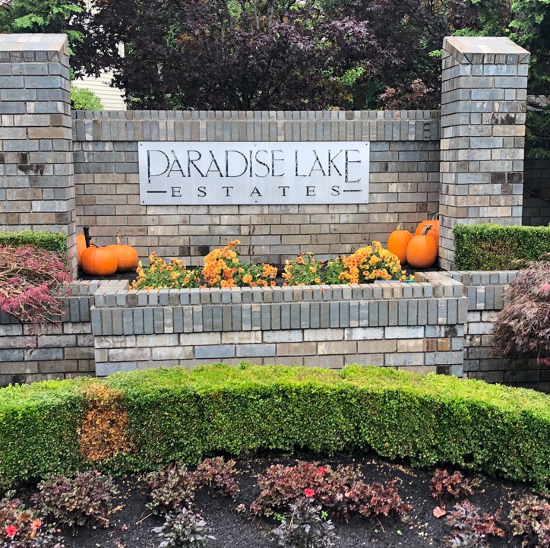
PLE HOA Annual Meeting
December 2022

Slide 2
Welcome Back!
First in person meeting since COVID
Hybrid meetings now
Recordings of HOA meetings available via PLEHOA.org
Comments and questions welcome
Ongoing dialogue with more opportunity for community input

Slide 3
Agenda
INTROS
2022 Update & accomplishments
Finance Update
NOMINATIONs &
ELECTION
Q&A, Comments

Slide 4
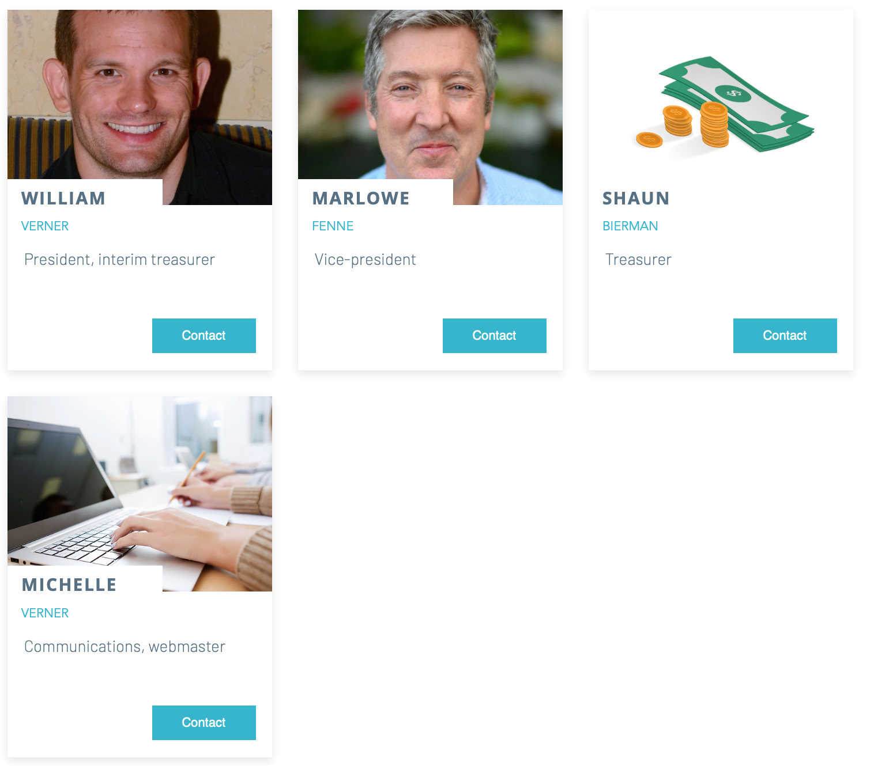
Current Board Members
Treasurer
Role Open
Thanks, Larry, for your service as interim Treasurer.

Slide 5
Welcome New Neighbors!
Please raise your hands.

Slide 6

2022 Accomplishments & Improvement
Taxes
State Registration
Web site, regular newsletters
Water meter, sprinklers (water leak still pending location)
Gravel refresh
Fence repair and cleaning
Improved trees & landscaping
Budget & Financial reporting

Slide 7
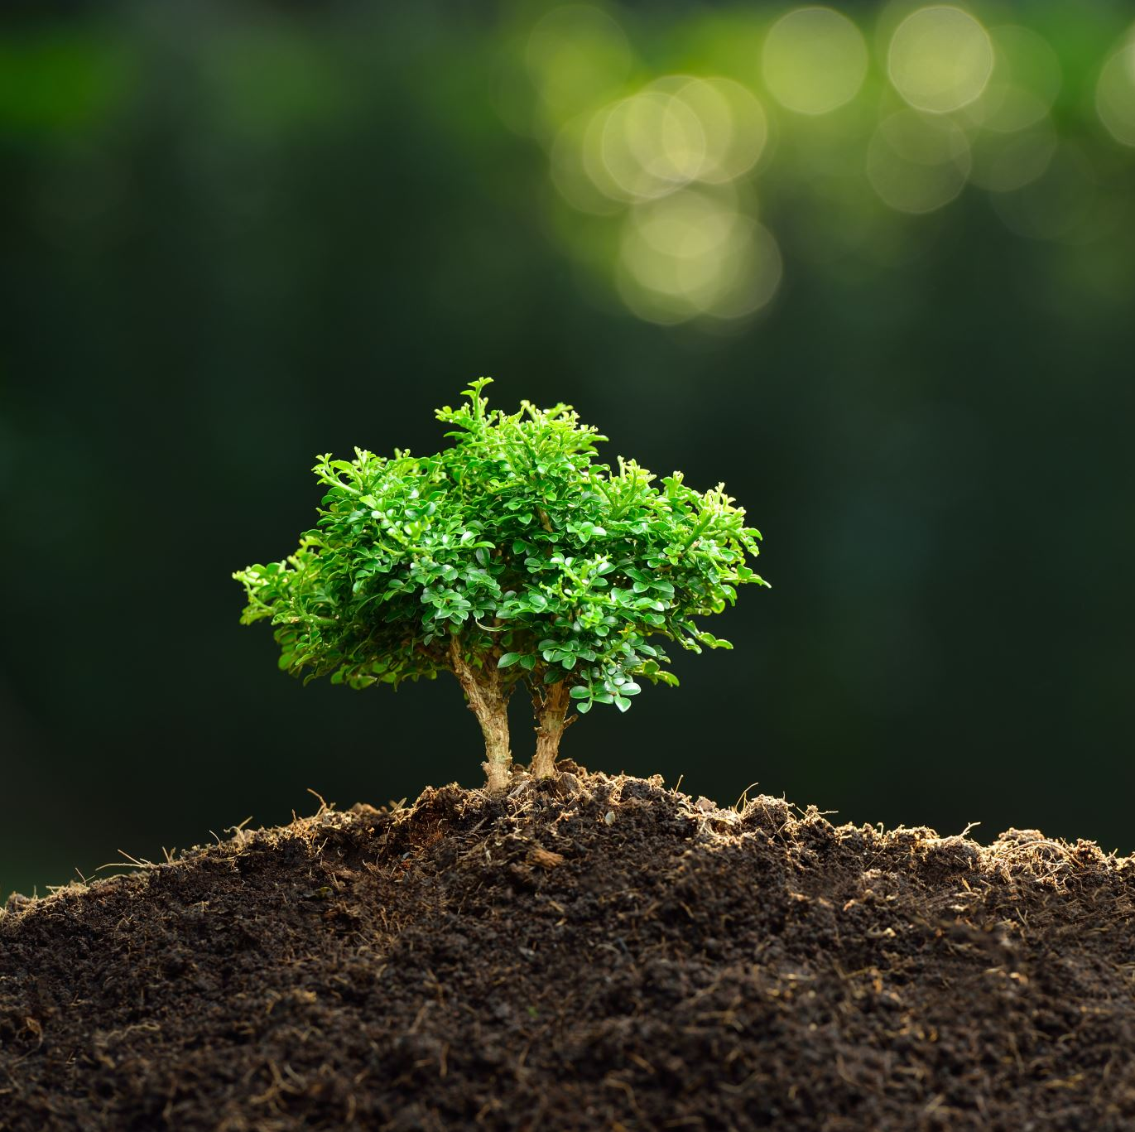
Possible 2023 Projects
Spring cleanup
More hazardous tree removal
Ongoing gravel maintenance – scope & cost?
Suggestions?

Slide 8
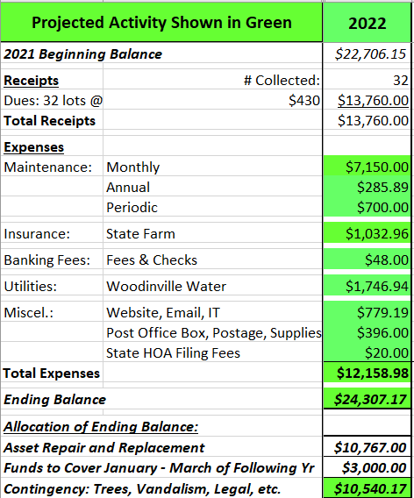
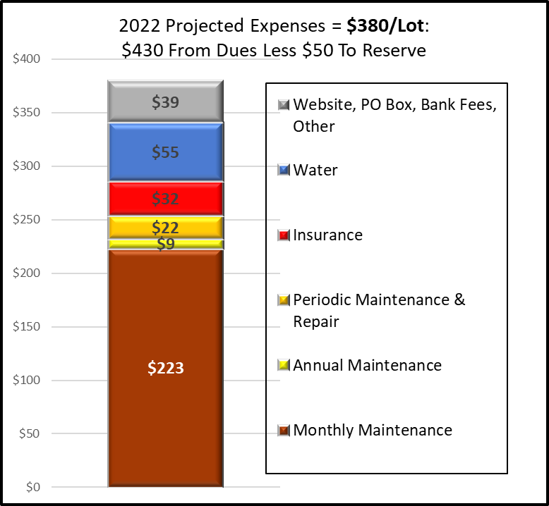
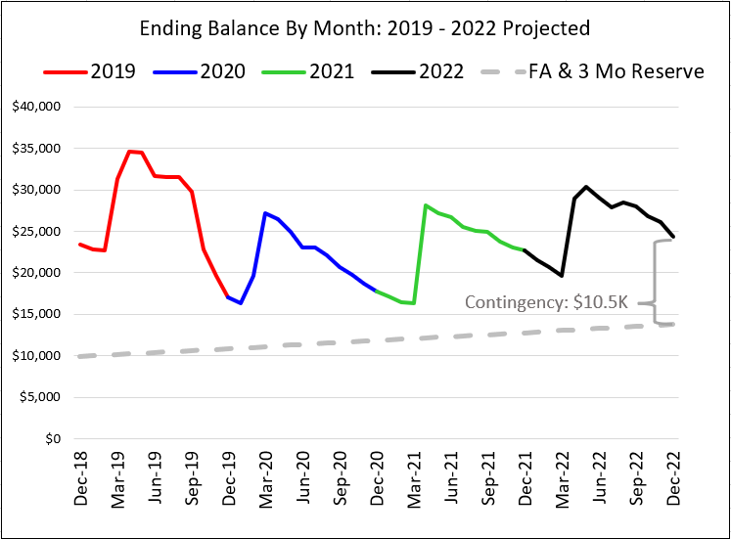
Financial Update
$24.3K YE Balance
  $11K Fixed asset replacement (fence, monument, and mailboxes)
  $3K cover the first 3 months
  $10.5 contingent (tree removal, irrigation leak, vandalism, etc.)
Spent $12K of $13K collected.
Notes:
Email from LarryR (12/05/2022) - “The $24.3K YE balance, ~$11K is for fixed asset replacement, $3K is to cover expenses for the first 3 months of next year before dues are received, and the remaining $10.5K is for contingent items like tree removal, irrigation leak detection and repair, vandalism, legal fees and other unforeseen or discretionary expenses. The level of volunteer effort may impact how much of that reserve will be consumed in 2023. ”

Slide 9

Nominations & Voting for Open Positions
President
Vice President
Treasurer

Slide 10
Thank You

Slide 11
Survey Results as of Nov 2020 - 15/32 responses in
Please complete your survey by January 15
Prior results

Slide 12
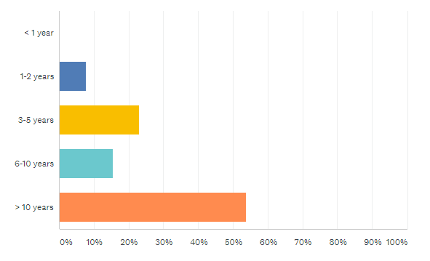
Survey results
How long have you lived in PLE?

Slide 13
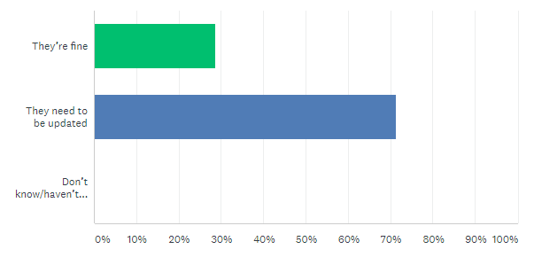
Survey results
How satisfied are you with the existing CC&R’s?

Slide 14
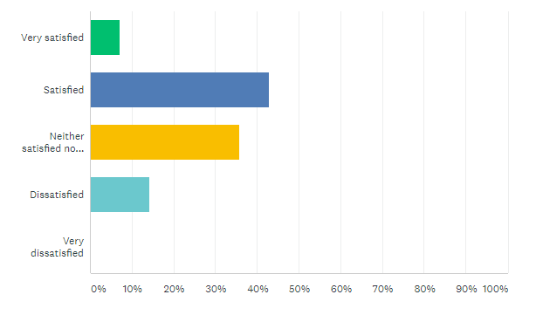
Survey results
How satisfied are you with the general appearance of the homes in PLE (roofs, paint colors, fences, etc)?

Slide 15
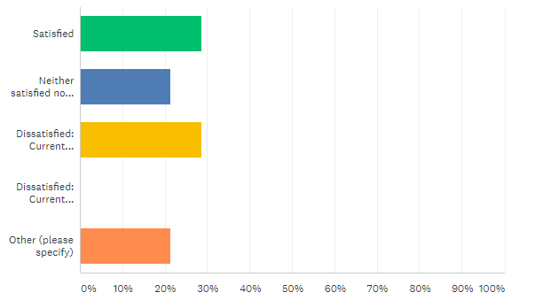
Survey results
How satisfied are you with the landscaping of the residences in PLE (gravel, grass, trees, shrubs, etc)
Most are compliant (neat and trim), while a few are not.
Unfortunately, I don't walk the neighbor to see every home. I would encourage initiatives such as Winter 20/21 the season to prune, Spring 2021 the season to Bark. Everyone if you can, give it a shot.
I get that we want the neighborhood to have a certain look since its $1M+ homes, but many people in the neighborhood have been around for 20 years and they don’t have the same level of expectation that the new folks do. If you want something different you have to bring more people along and expect a longer timeline for how long it will take to get people on board.

Slide 16
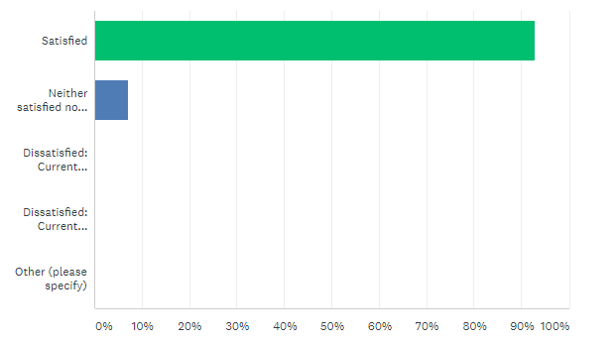
Survey results
How satisfied are you with the landscaping of the communal areas in PLE (gravel, monument, grass, trees, shrubs, etc)

Slide 17
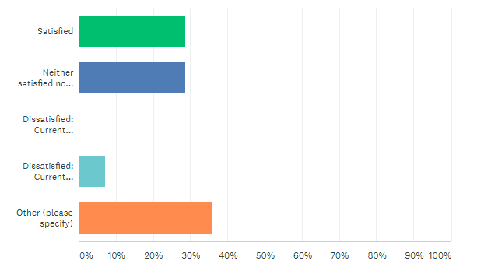
Survey results
How satisfied are you with the handing of boats and RV’s?
Can we update the CC&Rs to have more specific language to help prevent conflict? I don’t have a strong preference about how many times I see something, but I have seen plenty of arguments about it.
The term "actual current use" should be clearly defined and communicated. Our preference would be to limit boat and RV parking to three or four nights per month.
On my street, I don't see any issues with boats or RVs. If there is an issue elsewhere in the HOA i am just not aware.
People should be able to have more flexibility with these.
The CCRs have never explicitly outlines what is/isn’t acceptable. We need to be clear what is ok and what isn’t, and then hold people accountable.

Slide 18
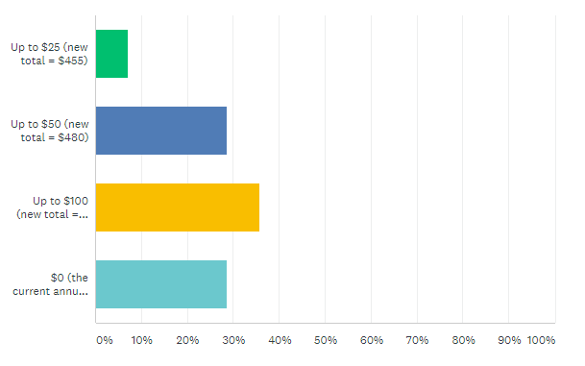
Survey results
How much would you be willing to raise annual dues to address more services and projects (e.g. annual gravel maintenance, more frequent landscaping)?

