Slide 1
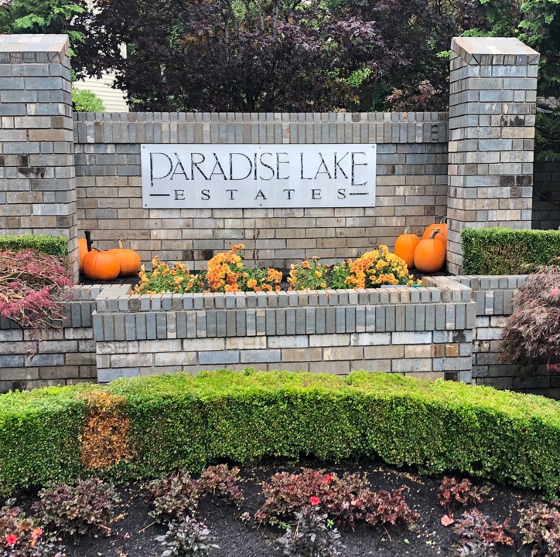
PLE HOA Annual Meeting
December 2023

Slide 2
Welcome Back!
Hybrid meetings
Recordings of HOA meetings available via PLEHOA.org
Comments and questions welcome
Ongoing dialogue with more opportunity for community input

Slide 3
Agenda
INTROS
2023 Update & accomplishments
Finance Update & banking Proposal
NOMINATIONs &
ELECTION
Q&A, Comments

Slide 4
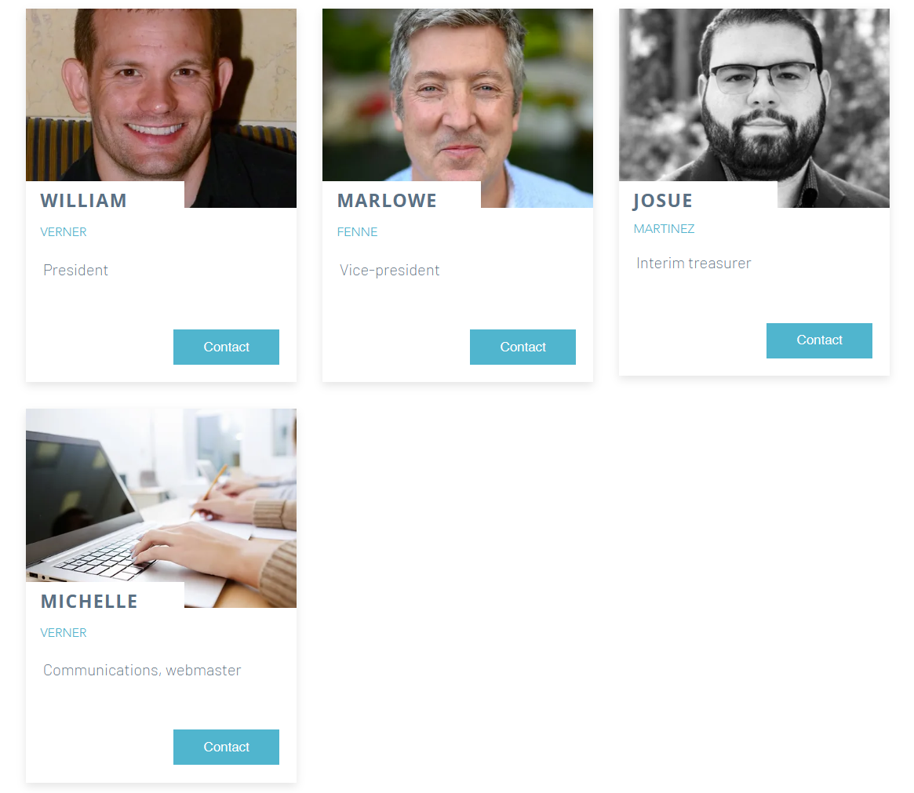
Current Board Members
Thanks, Larry, for your service as interim Treasurer prior to Josue joining.

Slide 5
Welcome New Neighbors!
Please raise your hands.

Slide 6

2023 Accomplishments & Improvement
Taxes and State Registration
Mailbox refresh (4 out of 7)
Web site and regular newsletters
Water leak fixed, backflow testing application submitted, winterized sprinkler system
Fence repair and cleaning
Improved trees, monument decorations, and landscaping
Budget & Financial reporting
Notes:
Thanks Larry! - working with several tree companies to get quotes for tree work, talking to the county on permits, mailbox refresh, treasure assistance, other things I’m sure I’m forgetting.

Slide 7
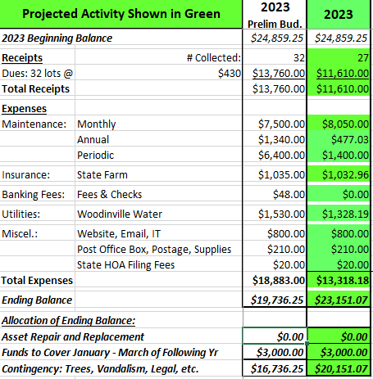
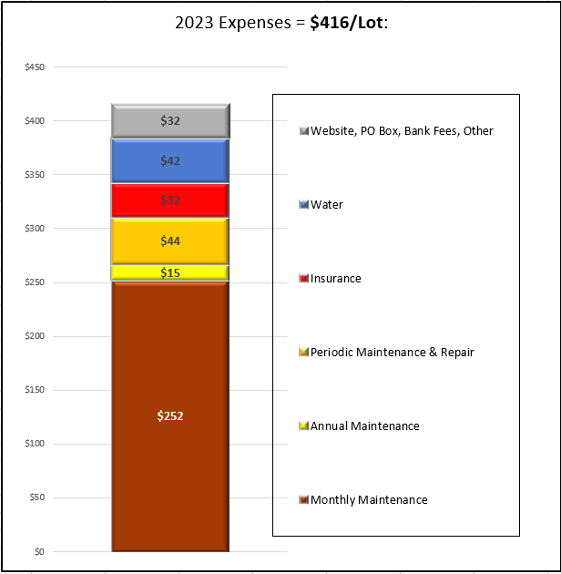
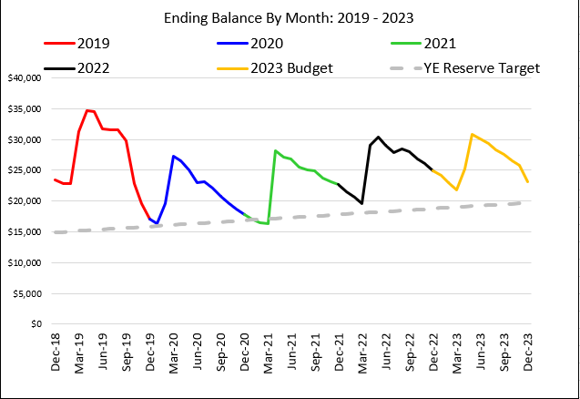
Financial Update
2023 YE Balance: $23.1K
  Missing $2.1k from delinquent payments
  Assumes tree removal in 2024
  Volunteer fence cleaning saved ~$700
Major Projects
  Gravel refresh ($1.4K) – Dec 2
  Tree removal (pending permits)
    Will be split into 2 projects in 2024/2025, each costing $3.6K
Maintenance Cost Adjustments
  Landscaping costs increased ~20%
  Water costs decreased ~50%
    2023 expenses include pipe reduction cost
Annual expenses are starting to approach income from dues
  +14% cash flow not including periodic maintenance (trees, gravel, etc.)
  +3% cash flow if gravel refresh becomes annual expense due to rain runoff

Slide 8
Banking Proposal
Current Structure
Proposed Structure
One business account with Banner Bank
No opportunity to earn interest
We have historically paid $4/mo for “online banking and bill pay” – (Finally) Removed in 2023
Dues must be collected via mailed paper checks, which are prone to fraud, cost postage, and increase collection time and effort
Bills are paid via paper checks or ACH where accepted
Move to a dual account structure
  Business Money Market with Washington Federal (WaFd)
  Business Silver with US Bank
Washington Federal provides:
  Highly competitive CD rates with favorable lockup periods for contingency funds
  No cost banking with $1k in deposits
  This would be our primary checking account
US Bank provides:
  Zelle for Business, enabling dues collection through Zelle instead of paper checks, at no cost to the HOA or its members
  No cost banking with $1k in deposits
  This would be for dues collection and contain a floating “hedge” of $1300 to cover 2 months of expenses

Slide 9

Key Benefits
Take advantage of higher CD rates from regional banks keen to attract business customers
Hedge against any potential instability in regional banking with an account at a large national bank for liquidity management
Zelle for Business enables free digital payments for bills and dues collection, reducing overhead for collection and improving audit trail
Both banks have local branches if needed
Expands HOA ability to tap credit, if needed, with relationships at regional and national banks

Slide 10

Possible 2024 Projects
Spring cleanup
  Mailboxes (finish remaining 3)
More hazardous tree removal
Ongoing gravel maintenance
  Individuals
  Common Spaces
Fence cleaning
Suggestions?

Slide 11

Nominations & Voting for Open Positions
Vice President
Treasurer

Slide 12
Thank You

Slide 13
Appendix

Slide 14
Survey Results as of Nov 2020 - 15/32 responses in
Please complete your survey by January 15
Prior results

Slide 15
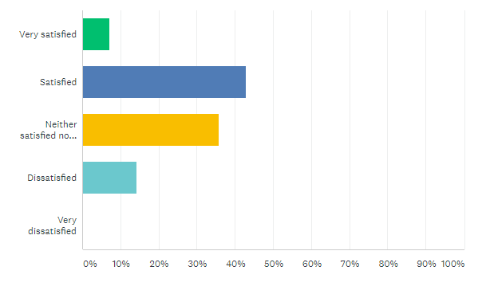
Survey results
How satisfied are you with the general appearance of the homes in PLE (roofs, paint colors, fences, etc)?

Slide 16
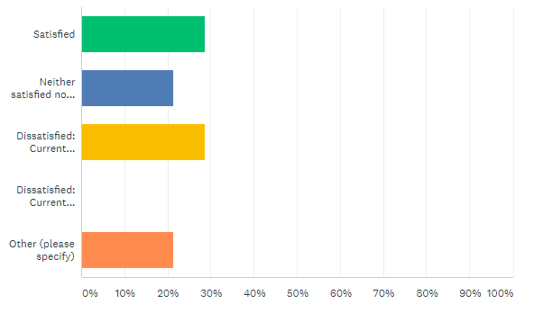
Survey results
How satisfied are you with the landscaping of the residences in PLE (gravel, grass, trees, shrubs, etc)
Most are compliant (neat and trim), while a few are not.
Unfortunately, I don't walk the neighbor to see every home. I would encourage initiatives such as Winter 20/21 the season to prune, Spring 2021 the season to Bark. Everyone if you can, give it a shot.
I get that we want the neighborhood to have a certain look since its $1M+ homes, but many people in the neighborhood have been around for 20 years and they don’t have the same level of expectation that the new folks do. If you want something different you have to bring more people along and expect a longer timeline for how long it will take to get people on board.

Slide 17
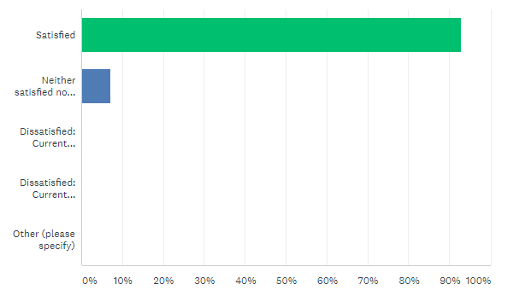
Survey results
How satisfied are you with the landscaping of the communal areas in PLE (gravel, monument, grass, trees, shrubs, etc)

Slide 18
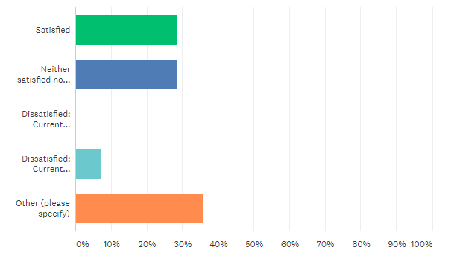
Survey results
How satisfied are you with the handing of boats and RV’s?
Can we update the CC&Rs to have more specific language to help prevent conflict? I don’t have a strong preference about how many times I see something, but I have seen plenty of arguments about it.
The term "actual current use" should be clearly defined and communicated. Our preference would be to limit boat and RV parking to three or four nights per month.
On my street, I don't see any issues with boats or RVs. If there is an issue elsewhere in the HOA i am just not aware.
People should be able to have more flexibility with these.
The CCRs have never explicitly outlines what is/isn’t acceptable. We need to be clear what is ok and what isn’t, and then hold people accountable.

Slide 19
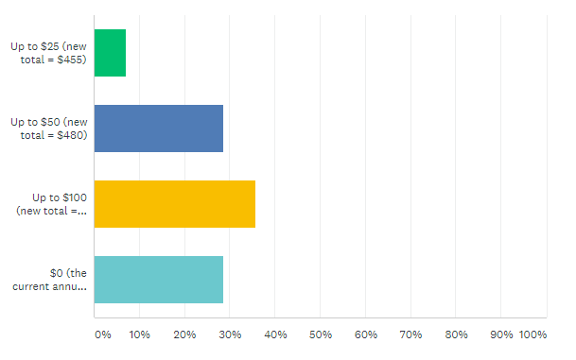
Survey results
How much would you be willing to raise annual dues to address more services and projects (e.g. annual gravel maintenance, more frequent landscaping)?

Slide 20
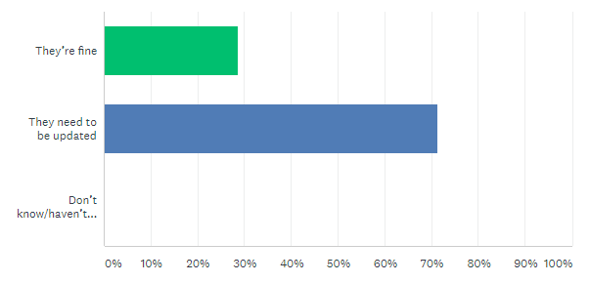
Survey results
How satisfied are you with the existing CC&R’s?

Slide 21
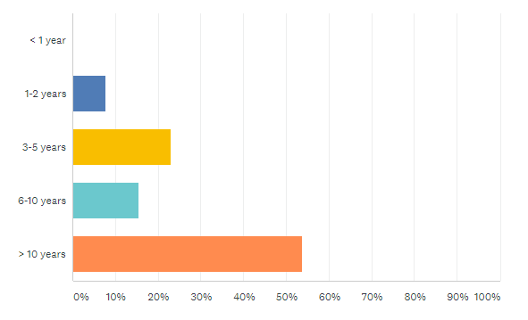
Survey results
How long have you lived in PLE?

Slide 22
Finance Proposal
Investment Option
Maintenance Option
Keep contingency fund of $8k in money market @ 0.80% APY
  Generates ~$64 in interest
Invest the remaining $12k in a CD ladder with WaFd
  $8k in 4 rolling 3 month CDs @ 4.85% APY, allowing $2k to mature each month to preserve liquidity
    Generates ~$295 in interest
  $4k in one 13 month CD @ 5% APY for higher interest
    Generates ~$220 in interest
Total 12mo Interest: ~$515
Spend ~$12k in maintenance ($9k in tree removal, $3k in gravel)
Keep contingency fund of $8k in money market @ 0.80% APY
  Generates ~$64 in interest
Total 12mo Interest: ~$64

Slide 23
Investment Option Visual
Jan | Feb | Mar | Apr | May | June | July | Aug | Sept | Oct | Nov | Dec | Jan | Feb
$2000 3mo @4.85% |  |  | $2024.35 |  |  | $2048.99 |  |  | $2073.93
 | $2000 |  |  | $2024.35 |  |  | $2048.99 |  |  | $2073.93
 |  | $2000 |  |  | $2024.35 |  |  | $2048.99 |  |  | $2073.93
 |  |  | $2000 |  |  | $2024.35 |  |  | $2048.99 |  |  | $2073.93
$4000 13mo @5% |  |  |  |  |  |  |  |  |  |  |  |  | $4222.17
CD ladder yields $295.17 in interest over the calendar year
13mo CD yields $222.17 in interest over the investment period
Ensures ~$7k is available each month for any contingencies

Slide 24
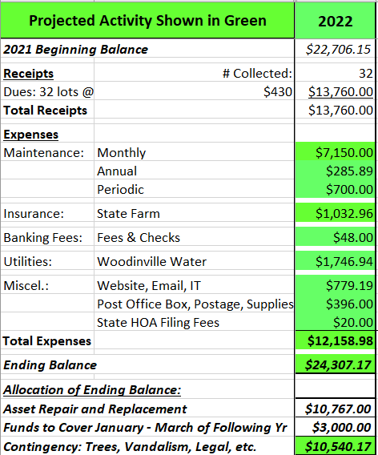
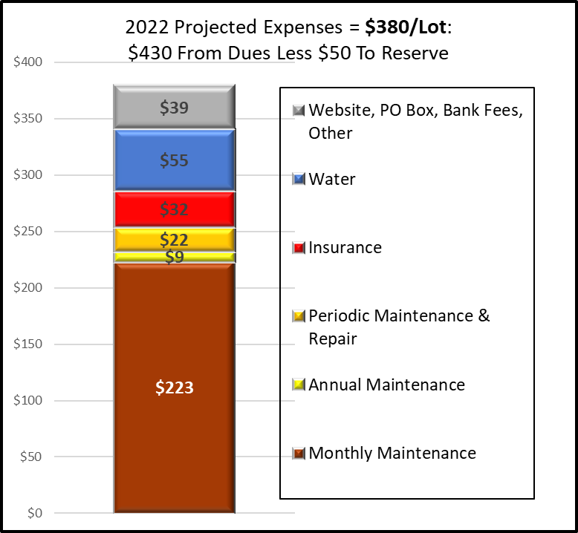
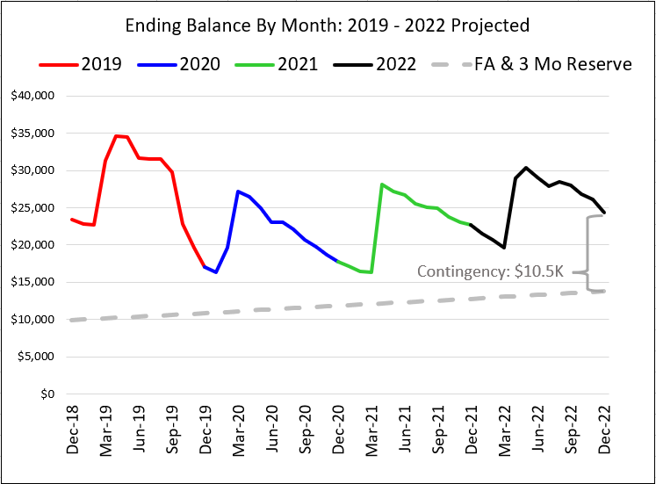
Financial Update
TO BE UPDATED
$23.1K YE Balance
$11K Fixed asset replacement (fence, monument, and mailboxes)
  $3K cover the first 3 months
  $10.5 contingent (tree removal, irrigation leak, vandalism, etc.)
Spent $12K of $13K collected.
Notes:
Email from LarryR (12/05/2022) - “The $24.3K YE balance, ~$11K is for fixed asset replacement, $3K is to cover expenses for the first 3 months of next year before dues are received, and the remaining $10.5K is for contingent items like tree removal, irrigation leak detection and repair, vandalism, legal fees and other unforeseen or discretionary expenses. The level of volunteer effort may impact how much of that reserve will be consumed in 2023. ”

